Slide 1
Information Visualization Visualization Sketch
G44-A
83440 – Cecília Baltazar
86416 – Francisco Sousa
86445 – João Daniel Silva

Slide 2
Overview
01

Slide 3
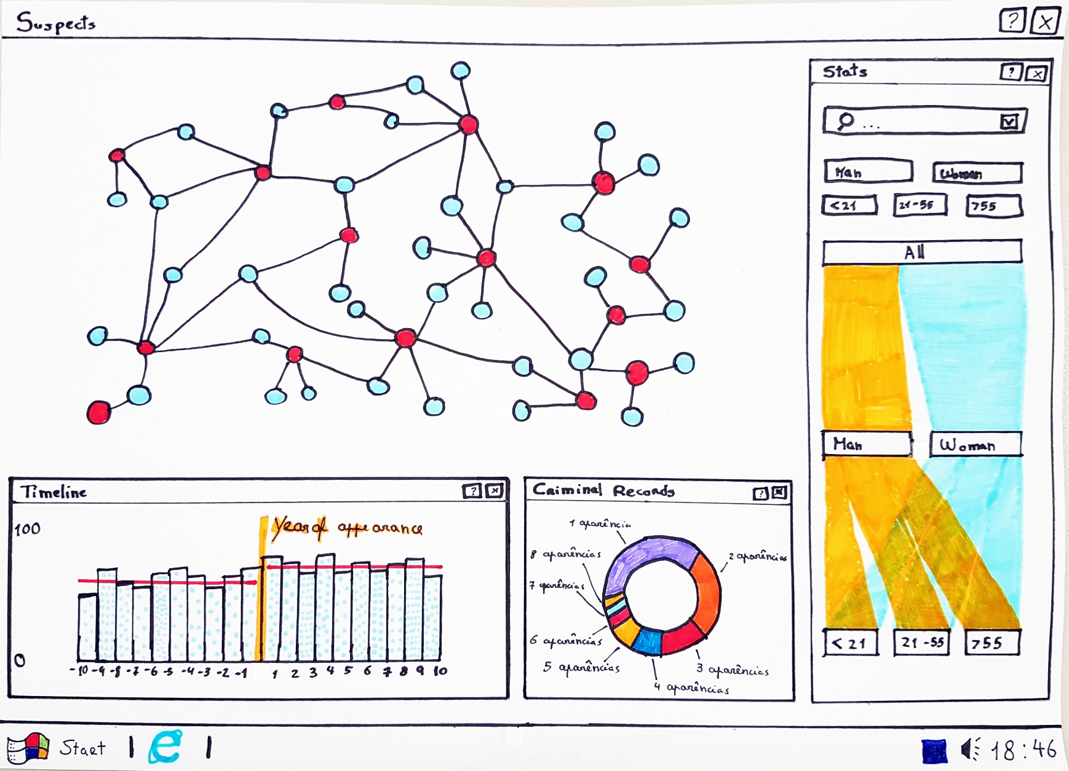
Overview

Slide 4
Visual encoding
02

Slide 5
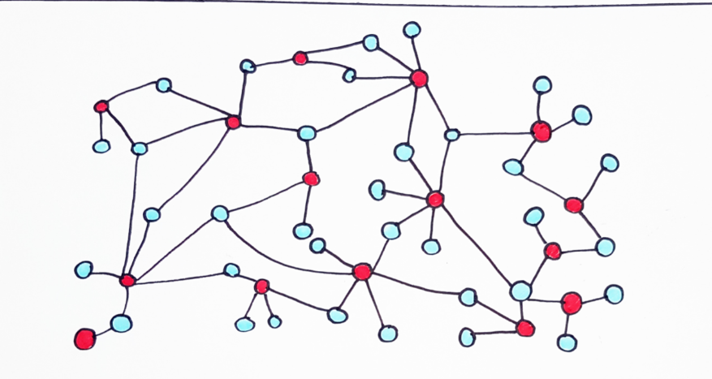
Visual Encoding
Network
Common works by guest stars
actors (type: nominal) and work (type: nominal)

Slide 6
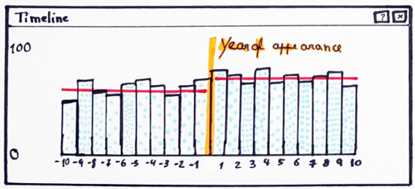
Visual Encoding
Bar Chart
Career progression of the actors
Frequency (type: ratio) rating (type: ratio)

Slide 7
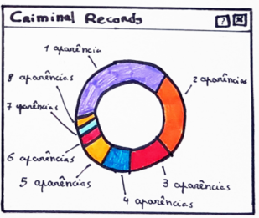
Visual Encoding
Doughnut
the number of appearances of the actors in episodes
amount of people (type: ordered)

Slide 8
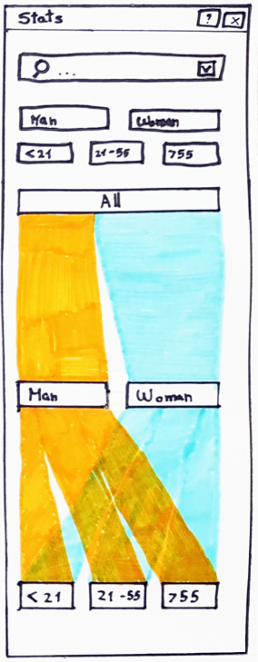
Visual Encoding
Sankey
Demographic of the actors
amount of actors (type: ordered)

Slide 9
Answering the Questions
03

Slide 10

Question 1 e 2
“Which guest stars participated in each movie/show?”
“Which actors have works in common?”

Slide 11

Question 3
“Do guest stars have several appearances on the show?”

Slide 12

Question 4, 5 and 6
“What’s the combined work frequency rating of the works they did before and after SVU?”
“How did career progress on average (all actors)?”
“How did their gender and age affect their career progression?

Slide 13

Storyboard
How are women’s careers affected by gender?
Go to the filter list and select “Women”
Compare the lines before and after SVU to understand how their gender affect the progression.

Slide 14

Question 7
“What's the gender and age distribution of actors in SVU?”

